Slide 1
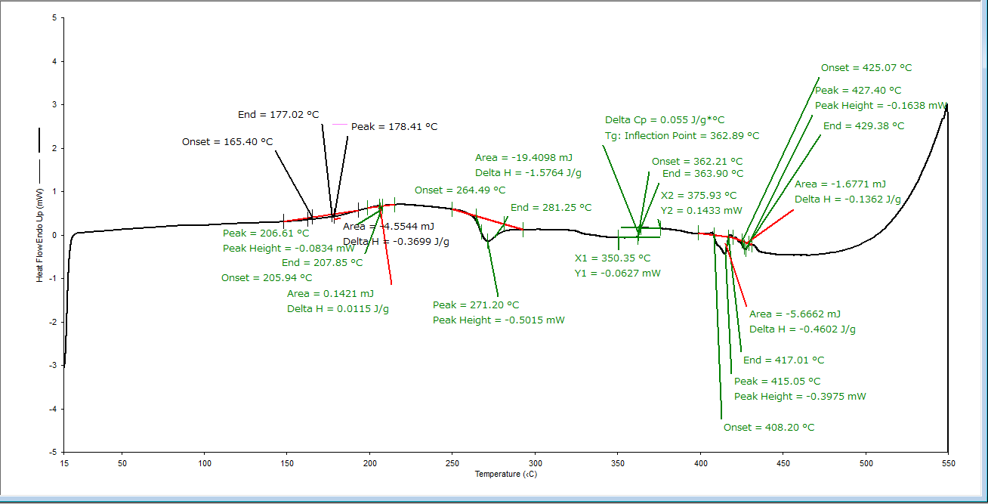
THE SPECIFIC HEAT OF SAMPLES FROM ASTEROID (101955) BENNU
J. Biele¹, A. Alasli², H. Nagano², C. P. Opeil^{3,4}, A. King⁵, A.J. Ryan⁶, R-L. Ballouz⁶, R. J. Macke⁴, H. C. Connolly Jr.^{6,7,8}, D. S. Lauretta²
¹RB-MUSC, DLR German Aerospace Center, DLR, 51147 Cologne, Germany (jens.biele@dlr.de); ²Nagoya University, Department of Mechanical Systems Engineering, Furo-cho, Chikusa-ku, Nagoya, 464-8601, Japan; ³Vatican Observatory, V-00120, Vatican City State; ⁴Department of Physics, Boston College, Chestnut Hill, MA 02467, USA; ⁵Natural History Museum, Earth Sciences/Mineral and Planetary, Cromwell Road, London SW7 5BD, UK; ⁶Lunar and Planetary Laboratory, University of Arizona, Tucson, AZ 85721, USA; ⁷Department of Geology, Rowan University, Glassboro, NJ, USA; ⁸Department of Earth and Planetary Sciences, American Museum of Natural History, New York, NY, USA.
Introduction
results
mineral composition: OREX-800107-103 (XRD-PSD); other data: preliminary estimations
Phase, empirical formula if estimation available | XRD wt% | abs wt% |  | std wt% | density (g/cm³) | std density (g/cm³)
Phyllosilicates | 68.9 | 64.70 |  | 1.4
Mostly lizardite? |  |  | 63.08 | 1.4 | 2.584 | 0.02
Few percent saponite ? |  |  | 1.62 | 1 | 2.620 | 0.1
Hydrate/interlayer water H₂O (up to 4 wt%) |  |  | 0.00 | 0 | 0.920 | 0.1
Magnetite, Fe_{2.98}Cr_{0.01}(Ca,Mg,Ti,P,Si)_{0.01}O₄ | 11.9 |  | 11.17 | 1.7 | 5.200 | 0.02
Pyrrhotite Fe_{0.859}Ni_{0.016}S | 10.7 |  | 10.05 | 0.7 | 4.610 | 0.3
Pentlandite (Fe_{4.4}Ni_{4.6})S₉ | 3.9 |  | 3.66 | 0.8 | 4.800 | 0.2
Dolomite CaMg(CO₃)₂ | 1.5 |  | 1.41 | 0.9 | 2.868 | 0.05
Calcite CaCO₃ | 0.6 |  | 0.56 | 0.3 | 2.711 | 0.05
Olivine (Mg_{0.96}Fe_{0.04})₂SiO₄ solid solution | 2.5 |  | 2.35 | 1.5 | 3.275 | 0.02
Forsterite Mg₂SiO₄ |  | 2.25 |  | 1.4 | 3.227 | 0.02
Fayalite Fe₂SiO₄ |  | 0.14 |  | 0.08 | 4.402 | 0.02
Organics, trace minerals, other |  | 6.10
low-Ca pyroxene, » Mg_{1.84}Fe_{0.16}Si₂O₆ |  | 0.80 | 0.50 | 0.3 | 3.350 | 0.1
Phosphates: MgHPO₃ ∙3H₂O, amorphous |  | 0.00 | 0.05 | 0.05 | 2.130 | 0.1
Apatite, Ca₅(PO₄)₃(F,Cl,OH) |  | 0.00 | 0.25 | 0.25 | 3.150 | 0.05
nano-diamond |  | 0.00 | 0.14 | 0 | 3.516 | 0.01
Spinel, Magnesionchromite, Chromite (Mg,Fe)(Al,Cr)₂O₄ |  |  | 0.20 | 0.09 | 4.080 | 0.4
Cubanite CuFe₂S₃ |  | 0.00 | 0.03 | 0.02 | 4.024 | 0.05
Chalcopyrite CuFeS₂ |  | 0.00 | 0.03 | 0.02 | 4.100 | 0.1
Organics IOM |  |  | 4.90 | 0.10 | 1.300 | 0.1
Other (unknown/unidentified) |  | 0.00 | 0.00 | 0 | 2.800 | 0.4
Total | 100.00 |  | 100.00 |  | 2.81 | 0.12
Table 1. Present estimation of absolute average mineral composition of Bennu including organics (IOM) material (estimation from organic C content and C mass fraction in organic matter, Foustoukos 2025). Once the phyllosilicate materials are more precisely determined, a theoretical cP(T) curve can be constructed and compared to experimental data.
Specific heat (at constant pressure) c_{P} depends on temperature and the mineralogic composition of a sample. It is important [1, 2] to know for the construction of accurate thermophysical models asteroid Bennu, where often only the composite quantity of thermal inertia is cited, where ρ is bulk density, k thermal conductivity. Knowledge of c_{P}(T) of the samples from Bennu is critical for comparing them to thermal inertia values determined remotely from orbit (e.g., [3]). Here we report the results of differential scanning calorimetry (DSC) on a sample of Bennu from 210 K to 450 K. Overlapping low-temperature data (2–300 K) is presented in detail by [4].
Figure 1. Specific heat of OREX-803224-0, 3-450 K: DSC data (red) and for comparison, the low-temperature data from [4] and a global fit (green curve) are shown. The accuracy is of the order of 1%.
Verwey transition
SAMPLES
High temperature decomposition
Noteworthy anomalies
We first performed trials with a powdered test sample, OREX-803121-0 (14.372 ± 0.001 mg), consisting of (loose, unsorted) material that may not necessarily be exactly representative of the sample collection as a whole and with mineralogy that has not been characterized. We optimized the measurement procedure and the drying protocol with his sample.
We then measured our definitive sample, OREX-803224-0 (13.804 ± 0.001 mg), a subset of a well-characterized (XRD), homogenized powder OREX-800107-0 that was produced from grinding >6 g of mixed Bennu material for bulk analyses [5].
The sample, in powder form, was containerized in aluminum calorimetry sample pans and left unsealed to allow physisorbed water to evaporate and diffuse out into the dry purging gas (N₂ with a purity of 99.99% plus a dehumidifier connected between the gas tank and DSC device to eliminate any residual humidity in the purge gas)
Our DSC c_{P} data show no detectable transitions or other anomalies (peaks, kinks) from 210 K to 450 K. The PPMS data overlap the DSC data presented here in the temperature range ~210 to ~280 K. At low temperatures, in the PPMS data, the Verwey transition lambda peak, diagnostic for magnetite Fe₃O₄, is seen at 122.0±0.5 K. Its amplitude is 38.5+/-3.8 J/kg/K, or 10% of the lattice specific heat [4]; quite similar peaks in specific heat have been observed in Tagish Lake and Tarda meteorite samples (Piqueux, Vu et al. 2021). [1]. The transition temperature depends on stoichiometry; our observed value is consistent [9] with δ=0 in Fe_{3(1- δ)}O_{4 .}
A Besnus transition at ~32 K for pyrrhotite is not detectable in the c_{P} data , which is inconsistent with ~10 w-% 4C monoclinic Fe₇S₈ pyrrhotite! Either Bennu pyrrhotite is not monoclinic or in a 5C* superstructure or the Ni-content suppresses this magnetic anomaly for most of Bennu's pyrrhotite. Recent magnetization measurements also do not show any magnetization signal near 32 K, nor near 155 K where a Morin-type transition in c_{P} was observed [10].
Figure 2. normalized DSC heat flow at high temperatures
Decomposition (?) seens to set in at 450..480 K (DSC baseline heat flow becomes strongly time-dependent) – maybe just smectite interlayer cation dehydration)
Thus, c_{P} as equilibrium property can only be defined up to ~450 K, maybe extrapolated to 500 K (TBC).
references
[1] Piqueux, S., et al., Journal of Geophysical Research: Planets, 2021. 126(11): p. e2021JE007003.
[2] Opeil, C., et al., Meteoritics & Planetary Science, 2020. 55(8).
[3] Rozitis, B., et al., Science Advances, 2020. 6(41): p. eabc3699, DOI: 10.1126/sciadv.abc3699.
[4] Opeil, C.P., et al., in this conference. 2025, LPI contributions
[5] Glavin, in this conference. 2025, LPI contributions #1079
[6] Cezairliyan, A., , and Ho, C.Y., eds. CINDAS Data Series on Material Properties, ed. A. Cezairliyan and C.Y. Ho. Vol. 1-2. 1988, Hemisphere Publishing: New York.
[7] Opeil, C., et al., LPI Contributions, 2024. 3040: p. 1661.
[8] Biele, J., et al., International Journal of Thermophysics, 2022. 43(9): p. 144, DOI: 10.1007/s10765-022-03046-5.
[9] J. García and G. Subías, The Verwey transition—a new perspective, J. Phys.: Condensed Matter 2004 Vol. 16 Issue 7 Pages R145
[10] Haines, C.R. et al., American Mineralogist 2020 Vol. 105 Issue 9 Pages 1404-1411
Methods
The instrument is a power-compensated Perkin Elmer DSC 8000 measurement system with Intercooler II as cooling system and N₂ as purging gas. Reference samples for calibration were sapphire (corundum, α-Al₂O₃) disks. The measurement procedure is the three-curve technique (empty, reference, sample) and uses the step-scan method of [MRaw, in 6] to eliminate most systematic instrument drifts.
Samples were heated and kept at 130° C (403.15 K) while purged in N₂ for 120 min to evaporate any adsorbed water before starting the measurements. We discovered that water adsorption on Bennu samples is a very critical issue. The sample mass changes significantly by about 4%, and the dried sample quickly reabsorbs water, with a time constant of ~30 minutes in laboratory air of relative humidity 46%. Even a residual terrestrial water contamination of only 0.2–0.4% is non-negligible, considering the high specific heat (~4200 J/K/kg) and specific enthalpies of sublimation or vaporization of ~2.7∙10⁶ J/kg of H₂O. DSC c_{P} or heat flux measurements for were performed from –50° C to 560°C (high temperature range). Temperatures > 450 K entailed irreversible decomposition with mass loss.
discussion
It was a surprise how rapidly the samples adsorbed water once in a normal (RF 26..46 %) laboratory atmosphere for handling, and how long it took to remove this physiosorbed water. Otherwise, the specific heat of Bennu in the temperature range investigated looks similar to some carbonaceous chondrite meteorites such as Aguas Zarcas (CM) [7], Tagish Lake (C2 ungrouped), and Orgueil (CI) (both from [1], in vacuum, i.e. “dry”). We will also compare observed specific heat with its theoretical value based on the mineralogical composition, following [8].
Please note the companion abstract [4] on the low-temperature (3–to ~300 K) c_{P} measurements using a sample from the same batch as OREX-803224-0. In the near future, the results of [4] and this study will be synthesized and compared to the expected values based modal mineralogy from XRD and organics analyses – our preliminary absolute “average inventory” of Bennu minerals is shown in table 1.
Acknowledgments
This material is based upon work supported by NASA under Contract NNM10AA11C issued through the New Frontiers Program. We are grateful to the entire OSIRIS-REx Team for making the return of samples from Bennu possible. We particularly recognize the contributions of the Sample Analysis and Curation Teams in enabling this work.

